Slide 1
Introduction to Flux: Next-Generation Resource Management for Exascale Workflows and Job Scheduling
¹University of Tennessee, Knoxville
²Lawrence Livermore National Laboratory
Presenters: Ian Lumdsen¹, Michela Taufer¹, Nigel Tan¹
Core Flux Team: Al Chu², James Corbett², Ryan Day², Jim Garlick², Giorgis Georgakoudis², Mark Grondona², Dan Milroy², Zeke Morton², Chris Moussa², Tapasya Patki², Barry Rountree², Abhik Sarkar², Tom Scogland², Vanessa Sochat², Becky Springmeyer², Jae-Seung Yeom²
JLESC Tutorial
April 15, 2024

Slide 2
Pre-exascale scientific workflows strain the capabilities of traditional HPC resource managers and schedulers.
Co-scheduling:
CG, analysis bound to cores nearest PCIe buses
Job comms/coordination:
36,000 concurrent tasks; 176,000 cores, 16,000 GPUs
Portability:
adapt tasks to different schedulers/managers
MuMMI: SC’19 best paper, SC’21 paper
MPI-based simulation with in-situ analysis plus AI/ML
Notes:
Several pre-exascale applications at LLNL, especially workflows, strained the capabilities of traditional resource managers
Example: MuMMI (Multiscale Molecular Modelling Infrastructure)
Studies the how the RAS protein interacts with the human cell membrane
RAS mutations are common in many types of cancer
Combines multiple molecular simulations with different granularities and ML to make the end-to-end simulation of RAS faster
MuMMI introduces several challenges to traditional resource managers, namely:
Task co-scheduling and coupling (e.g., CG sim and analysis must be bound to cores near PCIe buses)
Massive scale, which makes effects of co-scheduling worse
Portability to the small number of systems capable of running the full scale version of this workflow
OLD
Multiscale Machine-Learned Modeling Infrastructure: couples a macro scale model spanning micrometer length- and millisecond time-scales with a micro scale model employing high-fidelity molecular dynamics (MD) simulations to model RAS protein interactions with cell membrane. RAS protein mutations are involved in a large number of cancers. used up to 4000 nodes of the Sierra supercomputer, concurrently utilizing over 16,000 GPUs and 176,000 CPU cores, and running up to 36,000 different tasks
large length- and time-scales, yet at the same time molecular level details.
The “application” components (top) define the three scales and may be swapped to support other applications, whereas the “coordination” components (bottom) provide an interface to couple the associated tools, software components, and technologies to facilitate scalable simulation campaigns.
4 Coarse Grain simulations (one per GPU) on each node. Each CG simulation is bound to two CPU cores that share cache, to maximize the cache available to ddcMD. The corresponding analysis jobs occupy 3 cores for each CG simulation, totaling to 20 cores utilized by the CG simulations. In order to reduce latency in communication with GPUs, this 20-core partition is bound exclusively to the cores closest to the PCIe buses. The remaining 24 CPU cores per node are dedicated to CPU-only jobs and are either the macro simulation, a CG setup job, or the workflow manager.
CG simulation jobs in groups of four, several thousand jobs still run concurrently. Avoiding oversubscription, or placing too many jobs on the same node, requires the ability to coschedule multiple jobs on the same node based on heterogeneous resource requirements
More specifically, in order for MuMMI to start up to 36,000 concurrent tasks, we exploit Flux’s ability to hierarchically schedule sub-instances and to specify explicit bindings of resources.
SC19 best paper
Rat sarcoma virus

Slide 3
Next-generation, cross-cluster scientific workflows are demanding portability and cloud integration.
Complex workflows integrating cloud technologies at LLNL and beyond
Scalable message broker couples MPI-based tasks (AHA MoleS)
HPC simulation with AI/ML surrogates, orchestrated data (AMS)
Many other examples
2020 lab survey found that 73% of LLNL workflows interested in cloud integration
AHA MoleS: eScience’22 best paper
MPI-based simulation with analysis, AI/ML, containerized components
Notes:
Workflows run and scale anywhere.

Slide 4
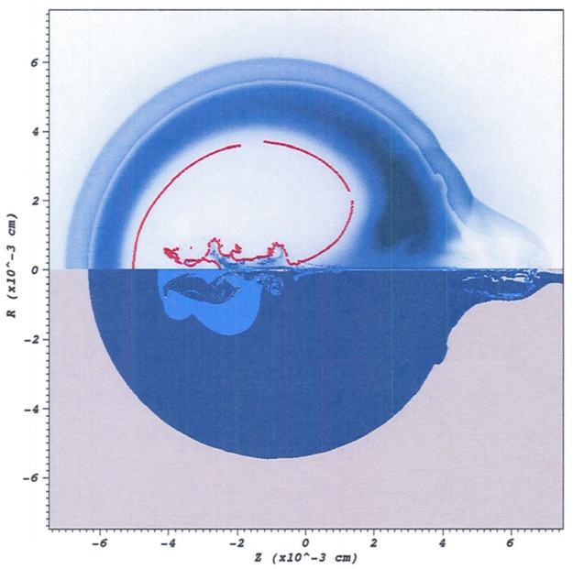

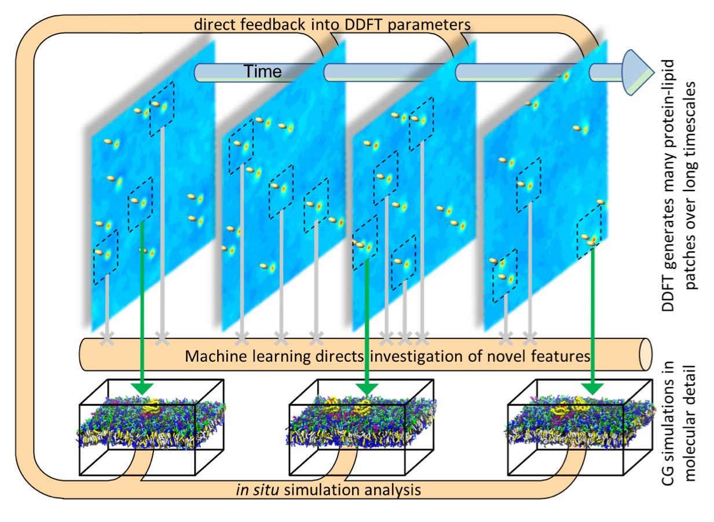
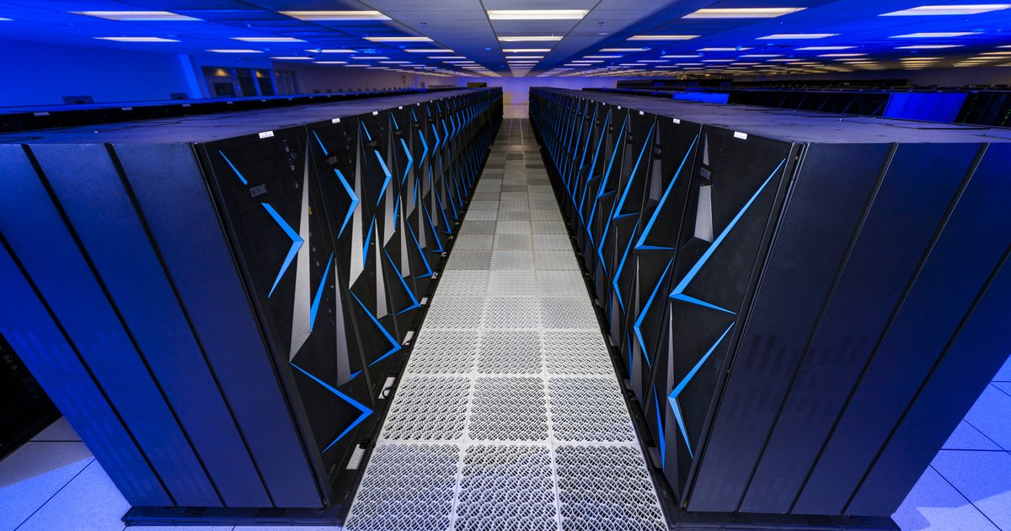
Trends towards complex workflows, extreme resource heterogeneity, and converged computing render traditional workload managers increasingly ineffective.
New pillar
Co-scheduling
Job throughput
Job communication/coordination
Portability
Extremely heterogenous resources
Notes:
There are significant trends toward complex workflows extreme resource heterogeneity and converged computing which are rendering traditional workload managers increasingly ineffective.
There are five principal challenges the first is the Co scheduling challenge where complex workflows require component coupling and Co-scheduling of different types of hardware such as CPU and GPUs.
The second is the throughput challenge where uncertainty quantification and other ensemble-based techniques can submit 10s of thousands of short running jobs which overwhelm traditional HPC RJMS.
Third is the job communication and coordination challenge: in this case workflows depend on data transfer between various components within a framework.
4th is the portability challenge: in order to make sure that an application runs across multiple platforms application designers and engineers need to port an app to a large variety of RJMS.
Finally we are starting to see extreme resource heterogeneity which stretches or exceeds the resource model capabilities of traditional HPC RJMS.

Slide 5

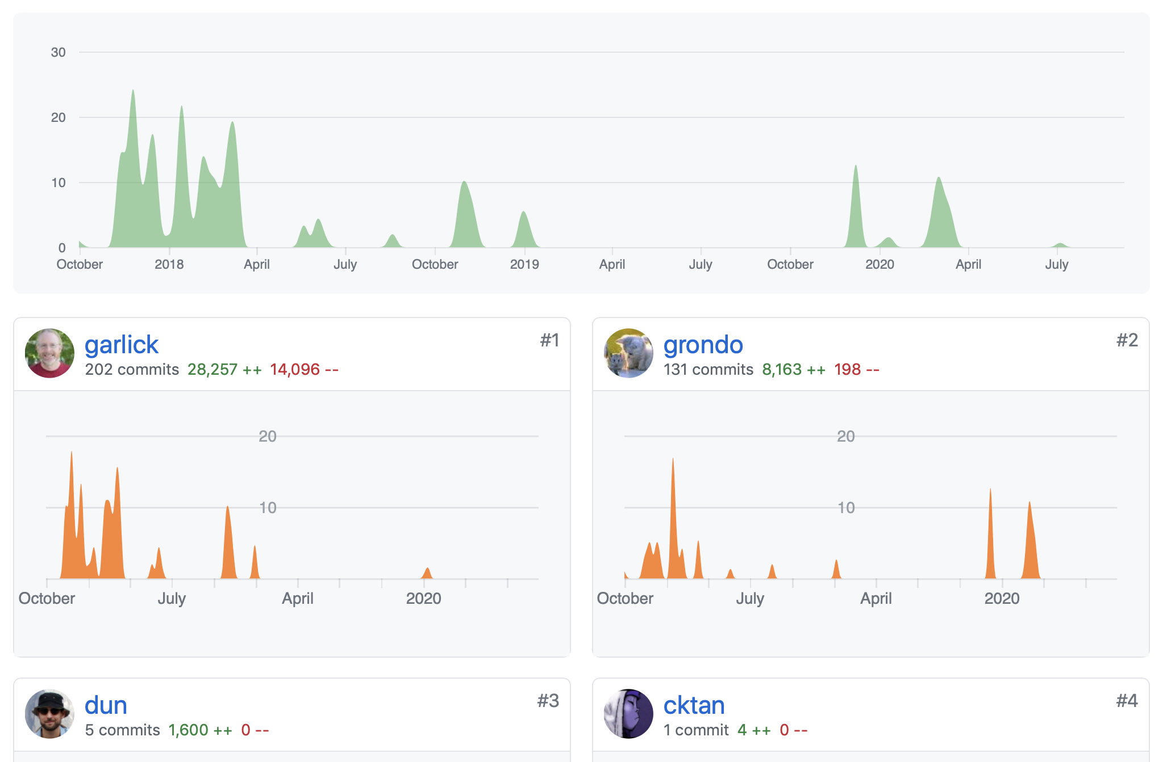

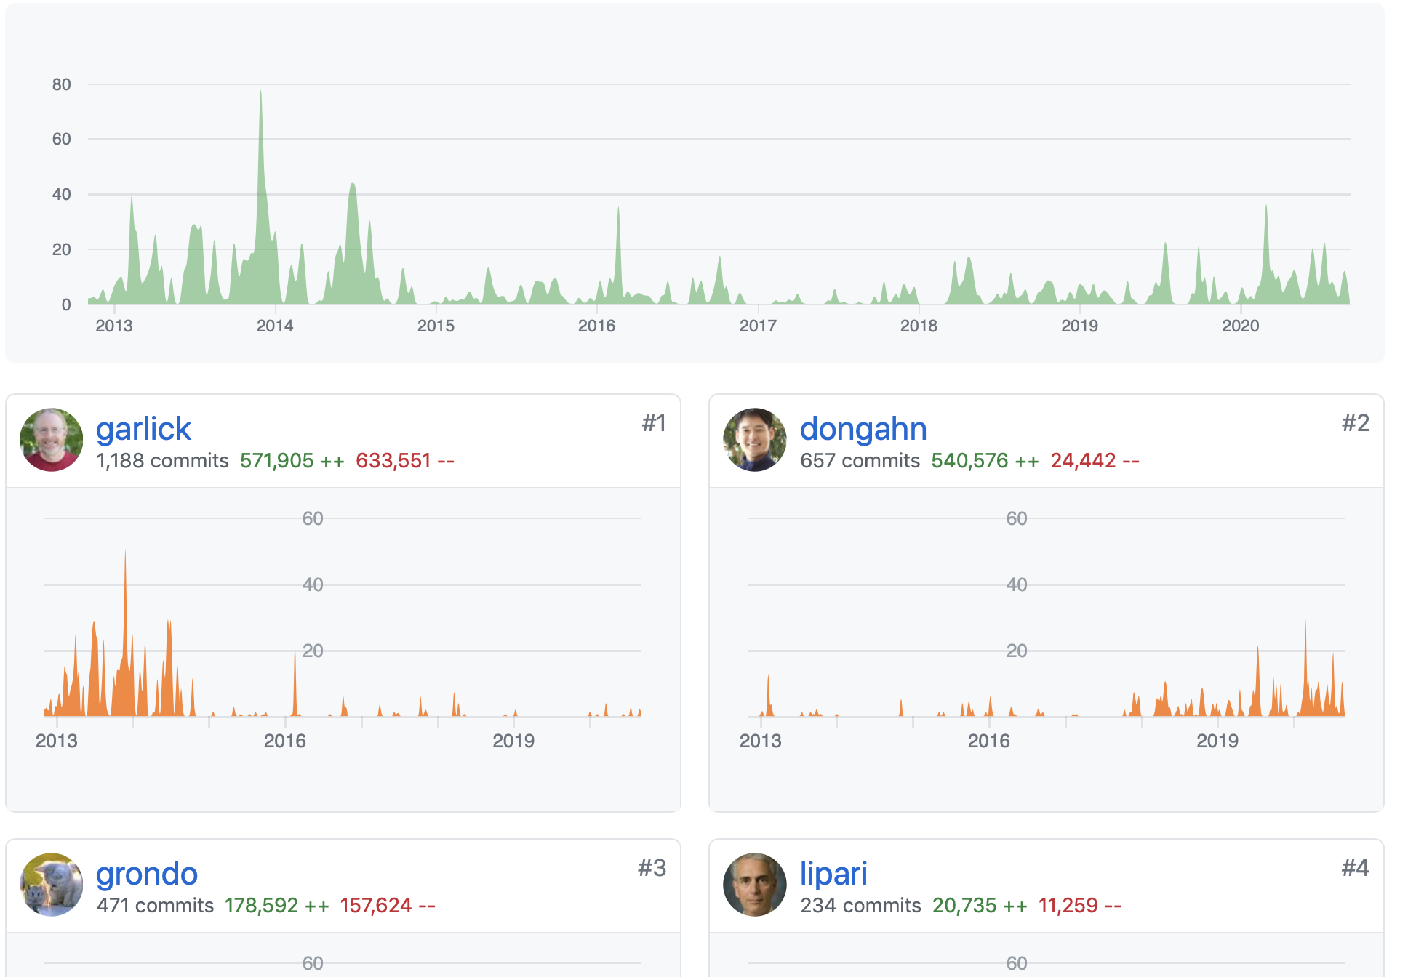

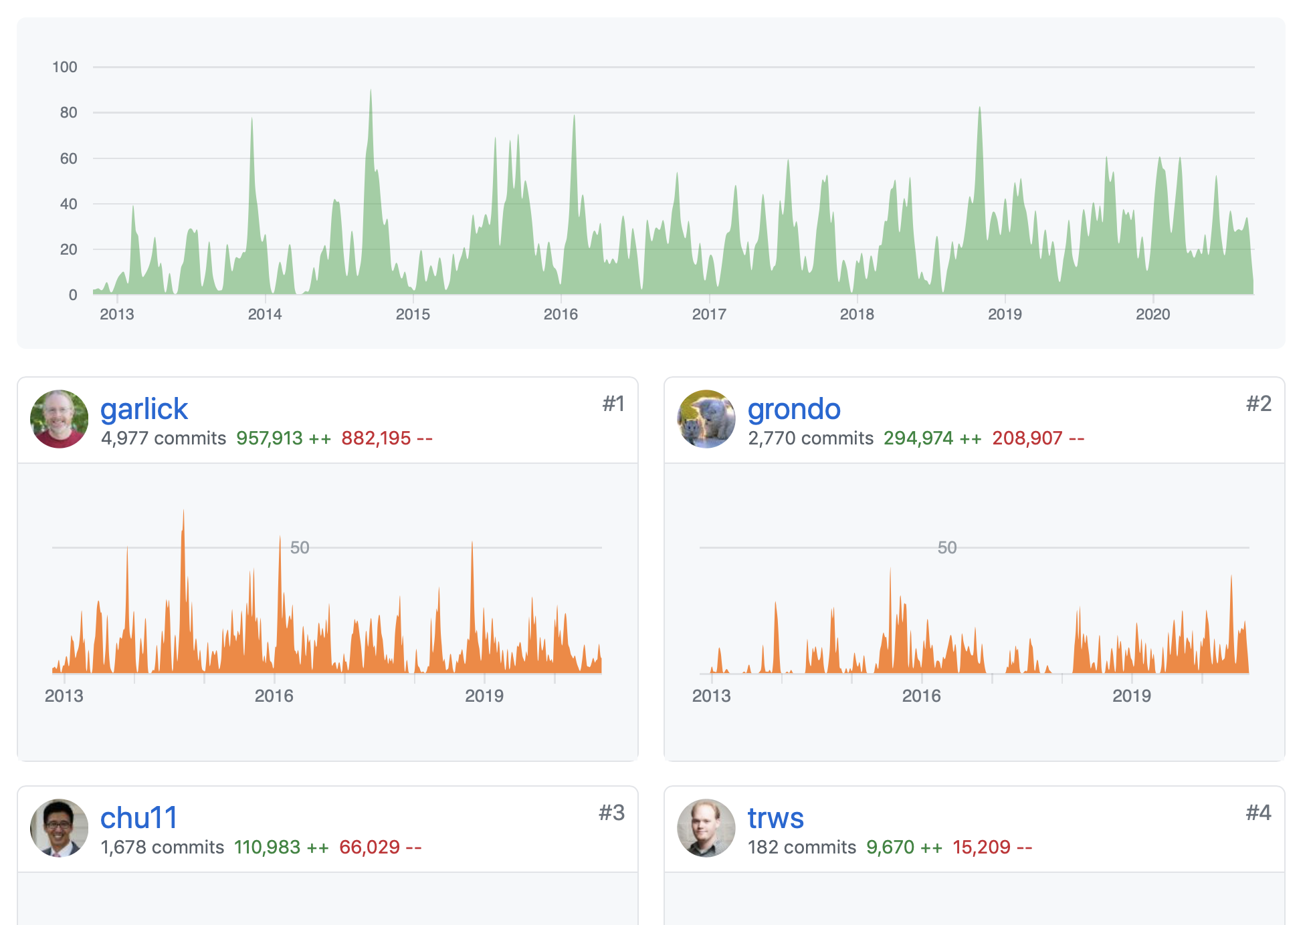

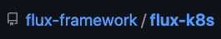
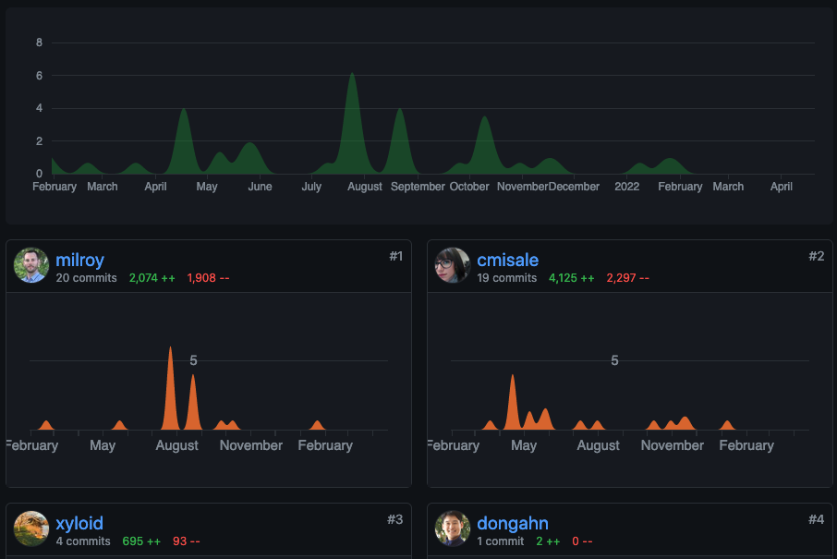

Flux solves key technical problems that emerge from these trends.
Open-source project in active development at flux-framework GitHub organization
Multiple projects: flux-core, -sched,
-security, -accounting, -k8s etc.
Over 15 contributors including some principal engineers behind Slurm
Single-user and System instance modes
Single-user mode in production for about 4 years
Multi-user mode debuting on LLNL Linux clusters
Plan of record for LLNL El Capitan exascale system
Notes:
Flux solves all five of these key technical problems. Flux is an open source project in active development. The GitHub flux framework organization is composed of multiple sub projects such as flux core and sched which is also known as fluxion. There are over 15 contributors to the project including many of the engineers behind the slurm RJMS. Flux has two modes: single single user mode's been around for over three years and multi user mode or system instance mode is the plan of record RJMS for the laboratory El Capitan exascale system

Slide 6

Flux hierarchical management and graph-based scheduling address exascale and converged computing challenges.
Modular, hierarchical design
Hierarchical resource management and scheduling (separate modules)
Sub-manager with specialized scheduler
Schedules cloud resources
Manages resources nearly anywhere
Bare metal resources, virtual machines in the cloud, HPC resources in another workload manager, pods in Kubernetes
Workflows only need to program to Flux
Directed graph resource model expresses complex, dynamic resources
Rich, well-defined interfaces
Facilitate communications and coordination among tasks within a workflow
CLI, Python, C, C++, Rust, Go (in progress), etc.
“Fractal scheduling” mitigates centralized scheduler bottleneck
handles high throughput
job steps needn’t hit central scheduler
Notes:
flux is fully hierarchical in terms of its architecture and uses this foundation to address deficiencies of the conventional scheduler/resource manager approach.
First, we have full workflow enablement support. Flux achieves this through resource subdivision. In the diagram you can see a top-level flux instance which instantiates one flux instance per node which in turn instantiates lower-level flux instances CPU or core level. This allows a sub resource manager per subdivision with a service specialization at each level.
Flux can manage resources from almost anywhere including bare metal resources, virtual machines in the cloud, etc. One of the major advantages afforded by Flux is that workflows only need to program to flux since flux can run inside slurm or other job managers/schedulers.
Finally, Flux provides rich and well-defined interfaces to facilitate communications between workload or workflow components, or other third-party API clients which is key for converged computing

Slide 7
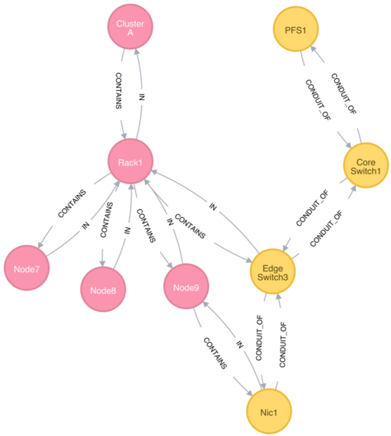
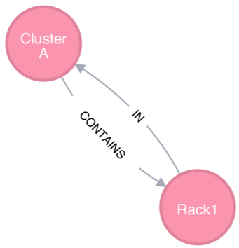
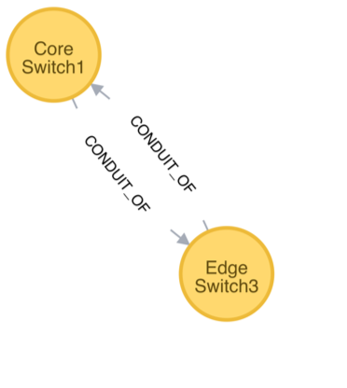
Flux pioneers and uses graph-based scheduling to manage complex combinations of extremely heterogenous resources.
Traditional resource data models are largely ineffective for resource heterogeneity
Designed with node-centric models when systems were simpler
Elevate resource relationships (edges) to an equal footing with resources (vertices)
Complex scheduling can be expressed without changing the scheduler code
Rich and well-defined C and C++ API (Golang soon) for graph allocation
Containment subsystem
Network connectivity subsystem
Notes:
flux also pioneers and uses graph based scheduling to manage complex combinations of extremely heterogeneous and diverse resources. Traditional resource models and their managers can't cope with extreme heterogeneity because they were designed when systems were node centric and the data structures they use to define the resource types are very simplistic. However flux or the fluxion scheduler uses a directed graph of resources which consists of a set of vertices which are the resources themselves and edges which define relationships between these resources, elevating resource relationships to an equal footing with resources themselves. Directed graphs can express complex scheduling logic without changing the scheduler code. Another advantage is that directed graphs facilitate elasticity or resource dynamism through well-defined procedures.
Designed when the systems are much simpler
Node-centric models
SLURM: bitmaps to represent a set of compute nodes
PBSPro: a linked-list of nodes
HPC has become far more complex
Evolutionary approach to cope with the increased complexity
E.g., add auxiliary data structures on top of the node-centric data model
Data structures can become unwieldy
Every new resource type requires new a user-defined type
A new relationship requires a complex set of pointers cross-referencing different types

Slide 8
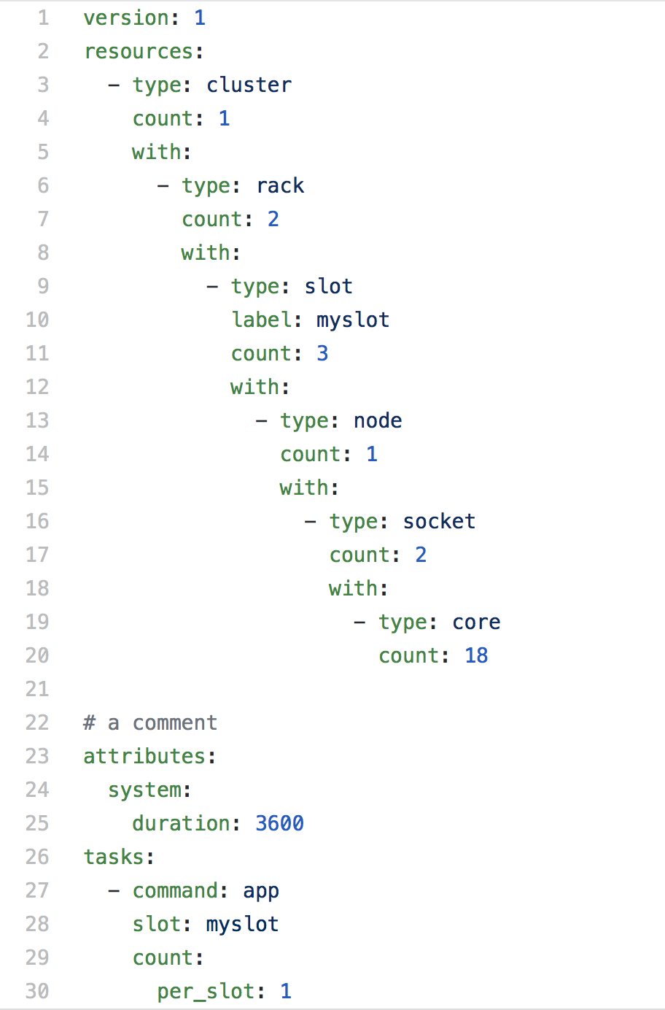
Flux’s graph-oriented jobspec allows for highly expressive resource requests.
Graph-oriented resource requirements
Express the resource requirements of a program to the scheduler
Express program attributes such as arguments, run time, and task layout, to be considered by the execution service
cluster->racks[2]->slot[3]->node[1]->sockets[2]->core[18]
slot is the only non-physical resource type
Represent a schedulable place where program process or processes will be spawned and contained
Referenced from the tasks section

Slide 9

Flux is running on LLNL production clusters in preparation for the deployment of El Capitan.
Rolling out on production systems, addressing user groups one at a time. El Capitan will be a leap.
Smaller clusters for user feedback (three are in the top 200 of the Top500)
Tioga, Corona (pictured here), RZVernal, Tenaya
Hetchy, Fluke, Elmerfudd
Notes:
Flux is beginning to get some experience as an official cluster-level resource manager though. As of the past year or so, Flux has started to be deployed on some smaller Livermore clusters.
The list of clusters running Flux currently includes Tioga, Hetchy, Corona, Fluke, Elmerfudd and, just this week, RZVernal and Tenaya. Tioga, Vernal, and Tenaya all place in the top 200 on the Top500 list---so when I say they're small, they're still pretty powerful. Pictured here is Corona.
Most importantly, however, Flux is planned to be the system resource manager on El Capitan, which is Livermore’s next huge supercomputer, and which is being delivered to Livermore from now until the end of the year. I happened to see some of the first infrastructure racks being installed just a few days ago. Flux more or less has to be the resource manager on El Cap, but I’ll go more into that later. And in fact Tioga, Tenaya and Vernal, the three I mentioned in the top500, are early access machines for El Capitan, which is part of the reason why they run Flux.
Livermore is also converting existing Slurm clusters to Flux, but due to inertia it’s coming along slowly. Users don’t like change and a switch to Flux would cause a lot of intense frustration as users figure out how to convert their existing scripts to the new resource manager.
Now, are there any questions on what I’ve gone over so far? This is the basic framework I’m going to expand on in the rest of my talk, so I want to make sure it makes sense.

Slide 10

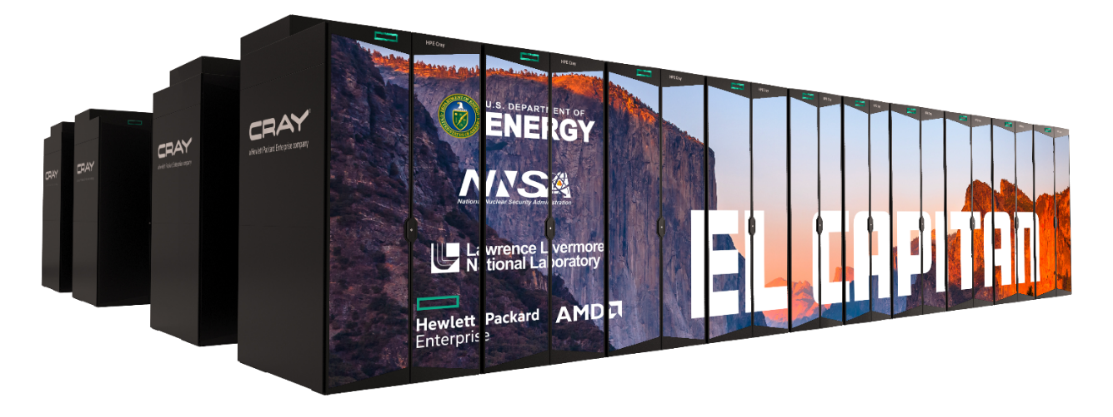
The rabbits of El Cap present a fearsome scheduling problem.
Multi-tiered storage features “rabbit” nodes
18 SSDs, direct PCIe to chassis compute nodes
Dynamically configured as node-local storage or job-global
node-local via PCIe, global via network
single rabbit can serve both at once
scheduler must handle both
Can be allocated independent of jobs
Too difficult for traditional schedulers
Notes:
While a lot of the architecture details of El Cap are still closely protected, it’s public that El Cap is going to have a multi-tiered storage system centered around nodes called “rabbits”. There will be one rabbit per compute chassis, which contains some small fixed number of compute nodes. I believe that on our early access machines the number is 16 or 18.
Each rabbit node will have an AMD EPYC processor and a collection of 18 SSDs with direct PCIe connections to the compute nodes on the chassis. HPE software will be running on the rabbit node, and will allow the SSDs to be dynamically configured to offer either node-local storage or storage common to all compute nodes in a job. Node-local storage is connected by PCIe, global storage is over the network. Global storage has to be over the network because you might have a rabbit on chassis A supplying a file system to compute nodes in chasses X and Y all the way over on the other side of the machine, to which the rabbit SSDs on chassis A have no PCIe connection. But given the network proximity and the fact that our backing file system at Livermore uses hard disks and not SSDs, we expect considerably better performance from the rabbit global file systems than the backing file system.
can be dynamically configured to be different kinds of storage makes them difficult to schedule. If a job asks for a global file system, the scheduler needs to be aware that it can pick any rabbit. If a job asks for node-local storage, the scheduler needs to be aware that when it picks compute nodes for the job, it must pick compute nodes whose rabbit has enough storage available. If a job asks for BOTH global storage and node-local storage, well, you get the picture. And in fact it gets worse, because there are multiple varieties of node-local storage, and a single job can ask for all of them. And it can even ask for multiple instances of each kind of storage.
Then there is the additional complication that users can allocate rabbits independently of jobs. This is useful for when users want to keep a file system around for multiple jobs to use at different times. But it means that the scheduler will need to be aware of resource allocations which have no compute resources associated with them.
That’s not the end of it though. There are further constraints about the number and types of storage that can be combined on a single rabbit. For instance, there is a limit on the number of NVMe namespaces supported by each SSD, so trying to create too many different file systems on a single rabbit will fail. The scheduler needs to be aware of that. Also, the Lustre file system is what underlies the global rabbit storage, and one of the lustre servers that runs on a rabbit requires a unique IP. This means there can only be one such server per rabbit. So the total number of lustre file systems that can be active on a cluster at any given time is equal to the number of rabbits.

Slide 11
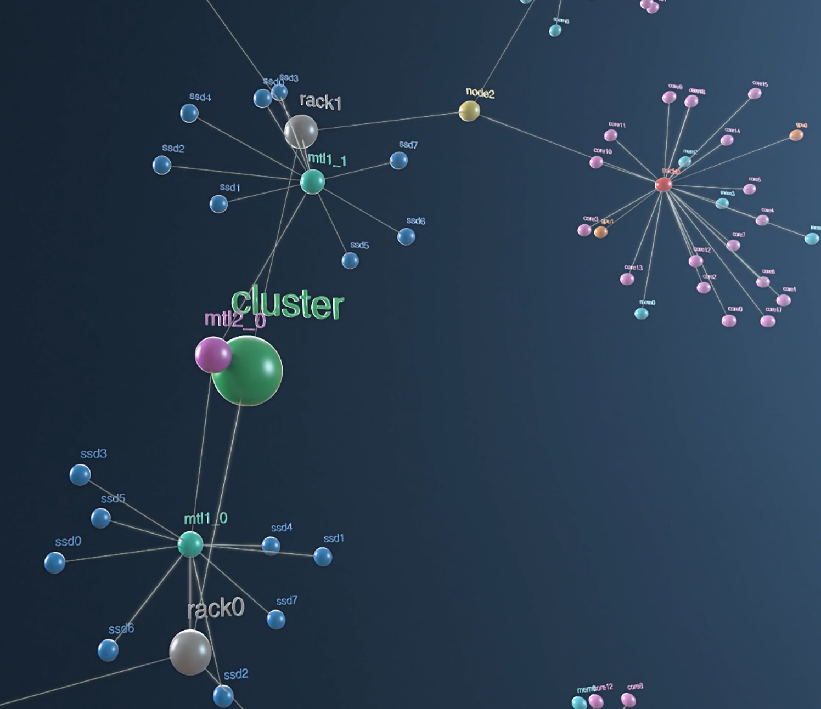
Fluxion’s directed-graph approach addresses the rabbit challenge and facilitates cloud integration.
Fluxion schedules rack-local and global storage with no code change (caveats)
inefficient for scheduling same resource type multiple times
affects jobs requesting multiple rabbit allocations
known issue to be fixed before El Cap deployment
Directed-graph representation enables scheduling, managing dynamic, cloud resources
selects SSDs anywhere
selects SSDs in same rack
Notes:
Fluxion’s graph approach can in theory handle all of the rabbit scheduling complexity with no code change. The rabbit nodes are a vertex in the resource graph, with edges from both “rack” (or chassis) and “cluster”, representing the fact that rabbits can be either a cluster-level or a rack-level resource. SSD namespaces are vertices associated with each rabbit, and each rabbit has a single “IP” vertex to ensure that two lustre file systems are not scheduled on the same rabbit.
But in the interests of full disclosure, Fluxion is wasteful when it needs to schedule the same resource type multiple times. Due to some of the optimizations Fluxion uses when exploring the resource graph, it doesn’t make the most efficient choices when it needs to pick the same resource type twice. This inefficiency affects all jobs that request multiple rabbit allocations.
Our current deployments make use of some workarounds to get efficient resource choices, but the workarounds will not scale to machines the size of El Cap. However, the fundamental ineffiiciency is planned to be fixed before El Cap is ready.

Slide 12

The what and why of movement to the cloud; HPC doesn’t want to be left behind.
The cloud is an environment (public, private) that supports:
Portability, reproducibility (e.g., containerization)
Resiliency, efficiency (e.g., resource dynamism, elasticity, declarative management)
Reduced complexity via automation (autoscaling, elasticity, declarative management)
CACM: New economic cycle of computing leads to greater hardware specialization. Areas more distinct and provide fewer benefits to others. Areas that get left behind³:
See little performance benefit
Market too small to justify upfront costs
Cannot coordinate demand (cloud)
Focuses on hardware, but software development is crucial, closely connected
Companies rent this environment; hugely profitable
projected to $920B by 2025, 20% CAGR (20-25)¹ vs HPC: $40B by 2025, 20-25 CAGR 8%²
¹Gartner 2022, ²Hyperion 2021, ³The Decline of Computers as a General Purpose Technology, CACM March 2021
Notes:
The what and why of the cloud
An environment that supports and facilitates:
Portability and Reproducibility (e.g., through containerization)
Resiliency and Efficiency (e.g., resource dynamism and elasticity, declarative management)
Reduced complexity through automation (autoscaling, elasticity, declarative management)
Could be on-premises, public, both
Companies rent this infrastructure; hugely profitable
Cloud: projected to reach $920B revenue by 2025, projected 20% Compound Annual Growth Rate (CAGR) (20-25) (Gartner 2022), vs HPC: $40B by 2025, 20-25 CAGR 8% (Hyperion 2021)
CACM, March 2021: new economic cycle of computing leads to greater hardware specialization. Domains will become more distinct and will provide fewer benefits to each other. Larger areas dominate more. Areas that get left behind:
See little performance benefit
Are not a sufficiently large market to justify upfront fixed costs
non-recurring engineering costs (NRE)
NRE costs increasing fast
Cannot coordinate their demand
Cloud companies play an important role in mitigating this effect by financing the creation of specialized processors and then renting these out.
Costs and benefits of cloud

Slide 13
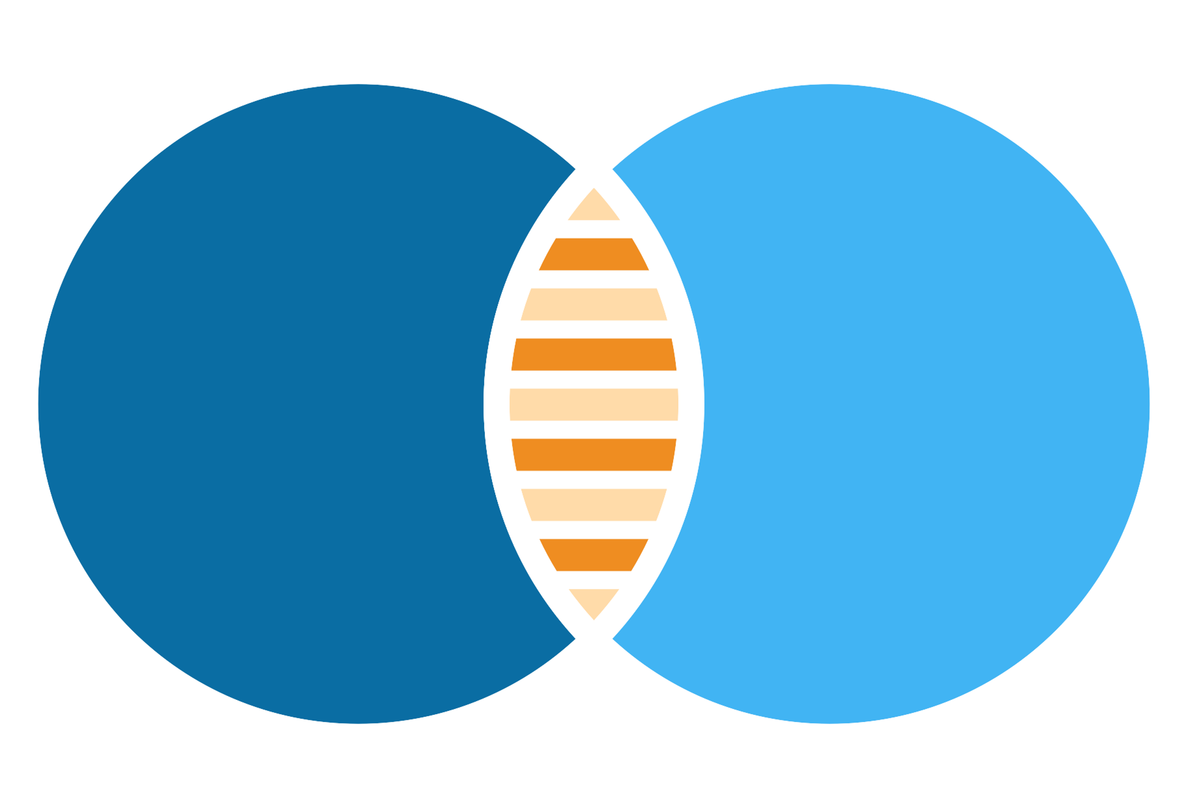
A key to converged computing is combining HPC scheduling and resource management with Kubernetes.
Converged Computing LDRD:
how to create a converged environment composed of the best of both worlds?
Kubernetes (K8s):
cloud “OS” with 75K contributors (one of the fastest growing OSS projects ever)
designed for loosely coupled apps
not focused on performance (scheduling limitations, throughput…)
HPC:
performance is in the name
very difficult to manage modern workflows
not designed for dynamism/elasticity
Kubernetes
HPC
Loosely-coupled apps
Tightly-coupled apps (MPI)
Schedule software resources
Schedule complex hardware
Lifecycle, network orchestration
Sophisticated queueing
Automation, declarative mgmt

Slide 14

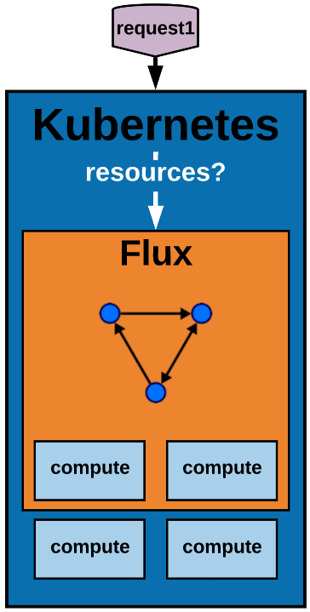
LLNL converged computing project advances convergence with representative, Flux-based models.
L1: APIs, resource representations, scheduling. Fluence enables portable converged workflows
L2: Flux Operator enables portable converged workflows
L3: Cloud nesting model reduces software complexity, increases automation, performance
L4: Elastic cloud nesting model enables autoscaling and dynamism
Portability is a component of performance!

Slide 15
The Fluence project improves performance and reduces workload variability.
kube-scheduler
Fluence
Fluence-scheduled workflows run up to 3x faster with low variability, deterministic placement¹
https://github.com/flux-framework/flux-k8s
¹One Step Closer to Converged Computing: Achieving Scalability with Cloud-Native HPC, 2022
Notes:
AMG then LAMMPS then QMCPACK (lonode policy)
Kube-scheduler uses random tie-breaking when nodes get same selection score (top half of heatmap)
KubeFlux allows different scheduling algorithms to optimize placement (bottom half of heatmap)
Kube-scheduler randomization causes delays where apps in a workflow don’t start despite enough resources (red cell borders), and multiple pods from the same app (cell color is number of pods, number in cell is number of apps)

Slide 16
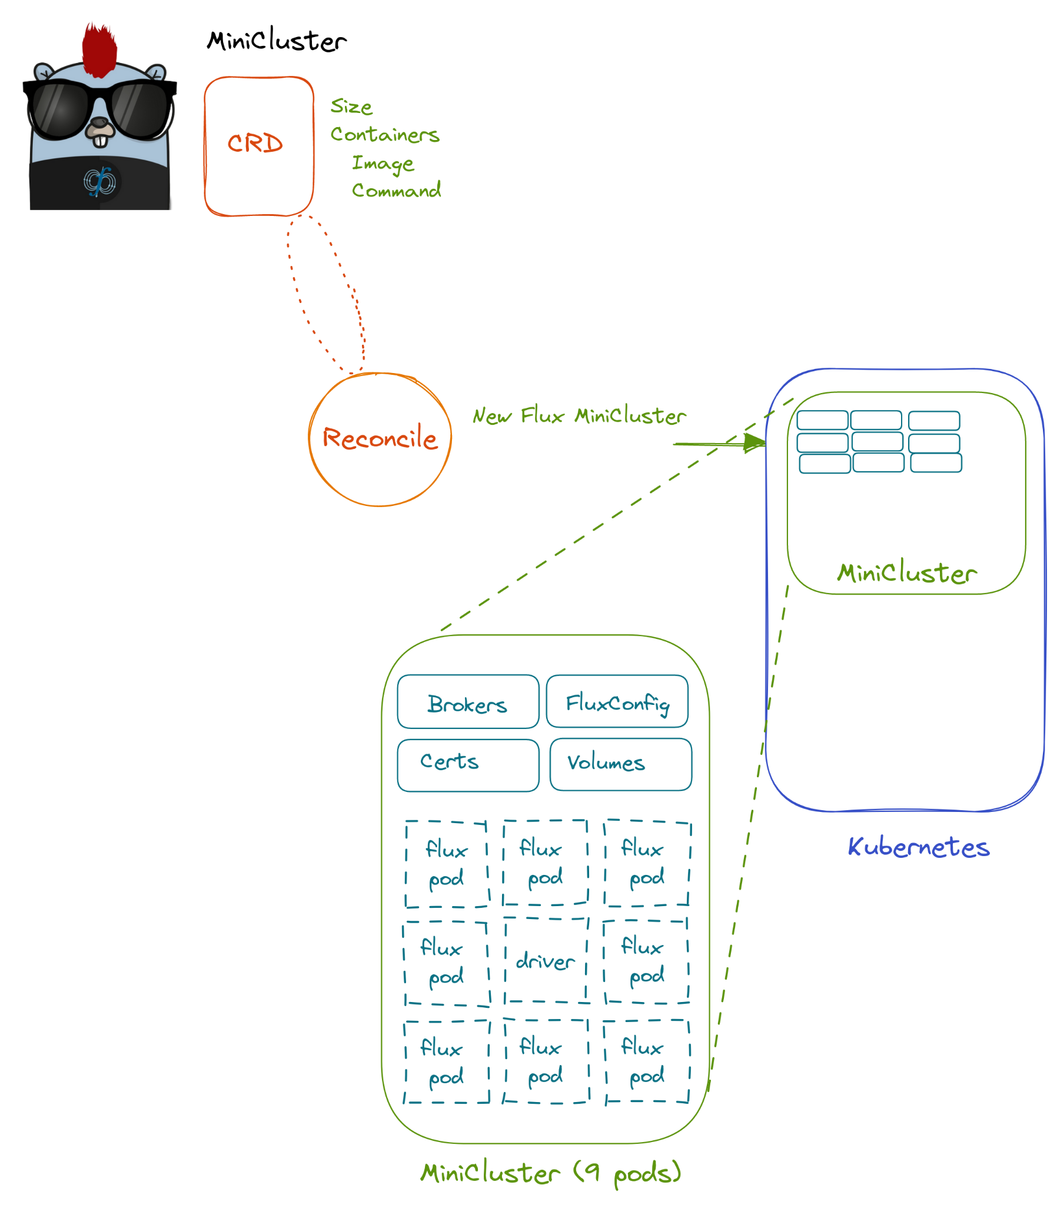
The project has enabled workflow portability via the Flux Operator.
Flux Operator
Bootstrap Flux in K8s; “fractal scheduling” of pods
Scalable MPI bootstrap
Ported 14 HPC benchmarks, tools, and full workflow
JobSet API
Autoscaling in progress
RESTful interface in progress
https://github.com/flux-framework/flux-operator

Slide 17





We formed industry and academic collaborations to tackle converged computing, contribute to community, and advocate for HPC.
IBM T.J. Watson Research Center:
Expertise in K8s Scheduling
UTK:
Science workflows, converged computing
Red Hat:
Developers of OpenShift K8s platform
LLNL:
Dan Milroy
Giorgis Georgakoudis
Md Rajib Hossen
Zeke Morton
Tapasya Patki
Abhik Sarkar
Vanessa Sochat
Jae-Seung Yeom
AWS:
Largest cloud platform, deep HPC expertise
Formalizing collaboration with Google!
Notes:
IBM T.J. Watson group brings HPC+cloud experience
Red Hat PSAP group enables K8s community engagement, container performance experience, and long-term contributions to code via repo upstreaming

Slide 18
Accessing the hands-on tutorial
Using our EKS cluster at https://tutorial.flux-framework.org
Choose a unique username (if not, you’ll be sharing a pod)
Password: rik3n-fl^x-2024
Navigate to flux-tutorial-2024/notebook/ and double-click 01_flux_tutorial.ipynb to start
To execute a cell in JupyterLab: Shift+Enter
It’s a shared instance- please don’t run computationally demanding tasks in your pod
The cluster will disappear shortly after the tutorial
Running locally with Docker:
git clone https://github.com/flux-framework/Tutorials.git; follow README in the 2024-RIKEN-AWS JupyterNotebook directory

Slide 19
Thank you!
Questions?
https://github.com/flux-framework/Tutorials.git

Slide 20
Flux is the embodiment of our fully hierarchical scheduling model.
Techniques
Challenges
Job Queue
Co-scheduling challenge
Job throughput challenge
Job communication/coordination challenge
Portability challenge
A
B
C
D
E
F…
Scheduler Specialization
Scheduler Parallelism
Rich API set
APIs, hierarchy
Flux framework

Slide 21

Updates on capabilities identified last year: Flux core team has made excellent progress leading up to production.
Support multiple queues/partitions
Support limits and defaults, boosted access/priority
Propagate time limits through job hierarchy
Replacement for batch #directives
CORAL2: rabbit integration, common tools interface
Start/stop Flux without losing running jobs
Resolve “second order” resiliency issues
Solved issues that surfaced during crashes, others will manifest at scale
Node-hosted prolog/epilog
Still need to launch pro/epilog from rank 0 host
Partial release of resources
Notes:
Support multiple queues/partitions
done
Support limits and defaults, boosted access/priority
Limits and defaults working, can adjust priority based on bank account, not quite ready for ”admin” accounts with infinite priority
Propagate time limits through job hierarchy
working
Start/stop Flux without losing jobs
systemd transient units contain first-level jobs, recovery by system instance
Replacement for batch #directives
implemented
Node-hosted prolog/epilog
Still need to launch pro/epilog from rank 0 host
Partial release of resources
Not done
Resolve “second order” resiliency issues
Solved thigs that happen during crashes, but many second order issues haven't manifested due to the hardware stability/system size
CORAL2: rabbit integration, common tools interface
Rabbits are on track, CTI?? (ask James)

Slide 22
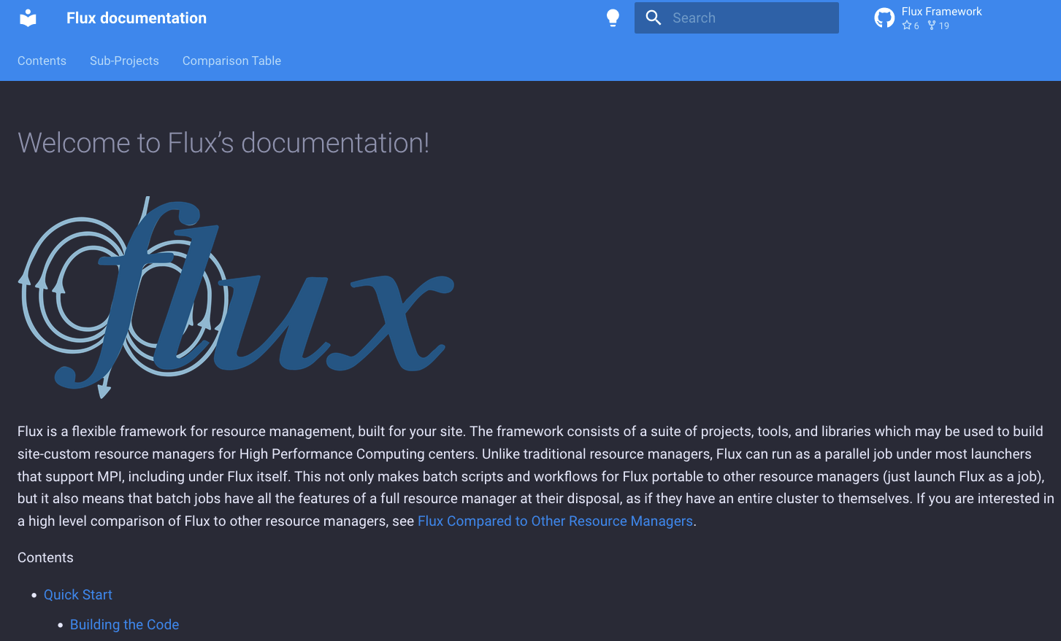
Flux is advancing rapidly. (Evidence: dark mode)
https://flux-framework.org/cheat-sheet/
Notes:
Uses systemd config files

Slide 23
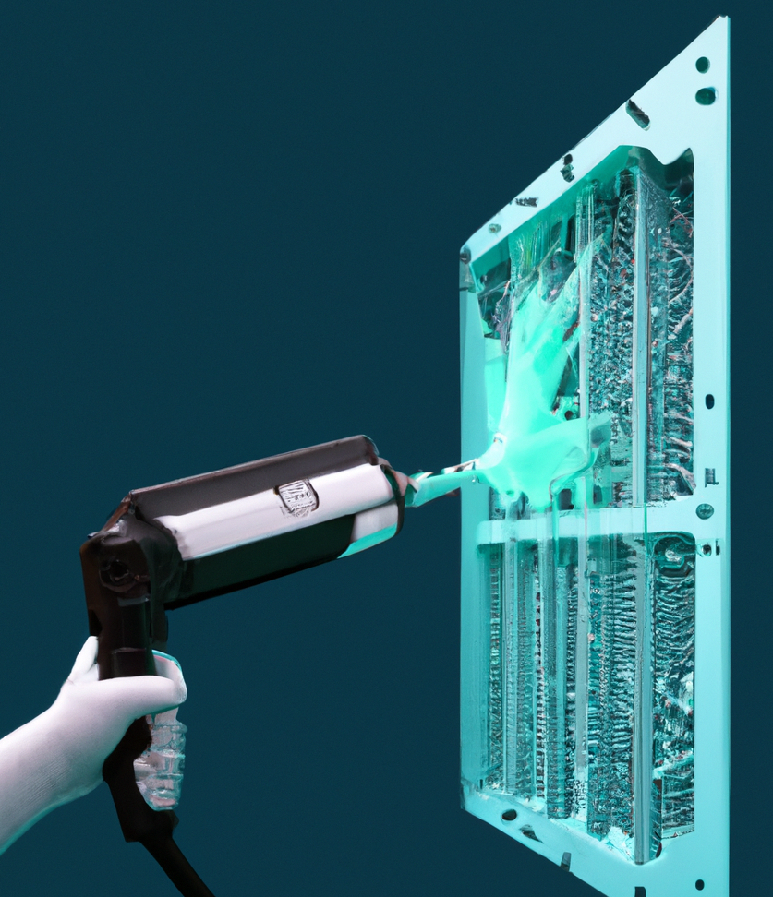
The Flux team is rapidly filling in user-identified gaps.
Deprecate flux mini, now flux run, flux submit, etc.
Introduce #flux: batch directives (flux-batch(1) man page)
Groundwork for executing jobs under systemd
eventually support Flux restart without running job loss
flux archive and job shell stage-in plugin for file broadcast
Support -o cpu-affinity=map: option explicitly map cores to tasks
RFC 34 Flux Task Map: a compact mapping between job task ranks and nodeids
Only prepend the path to flux(1) if necessary (avoid prepending /usr/bin to PATH)
Unbuffered I/O option for flux run and ability to direct stdin to subset of tasks
Support rank, host constraints in --requires= submission option
Notes:
Uses systemd config files

Slide 24
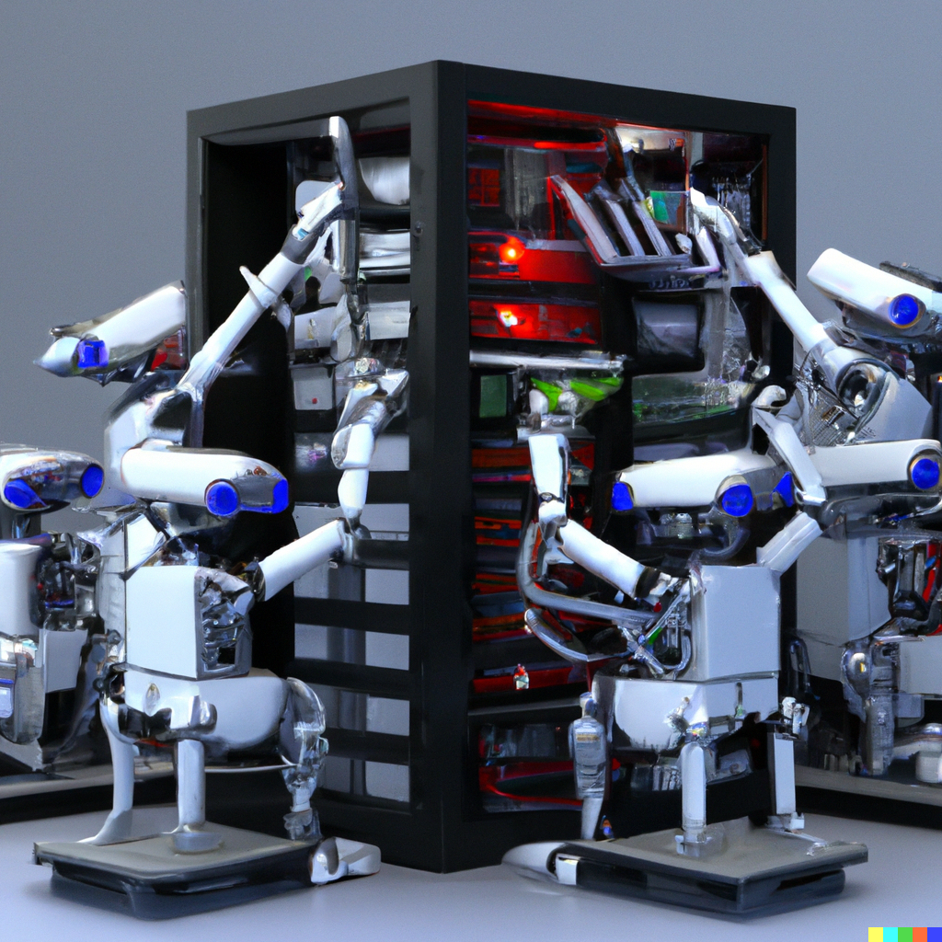
And providing new capabilities.
Side install Python bindings via flux-python
if Python not ABI compatible, pip install Flux bindings
must match Flux version of bindings and core
Send signal to a job before it expires
used to checkpoint before walltime
--add-file- attach small files to job submission
can be signed and saved to compute nodes
Flux-accounting runs as a service
run anywhere on cluster rather than mgt node
Plugin query callback
with multi-factor priority plugin, query returns user and bank’s job counts
explains limit enforcement
Notes:
add an input file for an application to jobspec: This associates the input file with the jobspec so that it does not need to be kept separately in the filesystem.

Slide 25
And providing new capabilities (cont).
new command flux-watch to watch output for a single or multiple flux jobs
Python API for monitoring job output
allow memory limits on jobs to be set for system instance jobs
easy configuration of batch job instances with --conf option to flux-batch and flux-alloc
Notes:
add an input file for an application to jobspec: This associates the input file with the jobspec so that it does not need to be kept separately in the filesystem.

Slide 26

The Flux team has developed utilities to improve user experience.
New utilities
flux job last - list last submitted jobs for the current user
takes slice option
flux job timeleft - get remaining time
flux pgrep and flux pkill - query/cancel jobs by name, id range, etc.
flux job taskmap - query taskmap for jobs
rank-to-host mapping
Notes:
Uses systemd config files

Slide 27



Enabling High Throughput Data Movement with the Dynamic and Asynchronous Data Streamliner (DYAD)
Existing Approaches for Data Movement
Advanced Data Movement with DYAD: Taking the Best of Both Existing Approaches
Sequential Approach
Easy to configure and run
Simple to integrate
Transparent to applications
Producer
Step 1
…
Producer
Step N
(1) Launch the DYAD Service
$ flux exec –r all \
flux module load dyad.so \
<producer directory>
C (and soon Python) Code
No Change Required!
Producer
Step 1
W
…
C++ Code
#include <dyad_stream_api.hpp>
using namespace std;
void write_file(char* fname,
void* buf,
size_t buflen)
{
dyad::ofstream_dyad ofs;
ofs.open(fname, ios::binary);
ofstream& real_ofs =
ofs.get_stream();
real_ofs.write(buf, buflen);
ofs.close();
}
/ssd/$USER/file.txt
Consumer
Step 1
…
Consumer
Step N
Local Storage
Strengths: easy-to-use, portable across storage solutions
Weaknesses: slow, dependent on parallel file system
(2) Configure DYAD for Apps
export DYAD_KVS_NAMESPACE=…
export DYAD_PATH_PRODUCER=…
export DYAD_PATH_CONSUMER=…
UCX
Flux KVS and RPC
Local Storage
In Situ/In Transit Approach
Producer
Step 1
…
Producer
Step N
(3) Load the DYAD Wrapper (when not using C++ API)
export \
LD_PRELOAD=“dyad_wrapper.so”
/ssd/$USER/file.txt
R
Consumer
Step 1
…
Consumer
Step 1
…
Consumer
Step N
Application sees read from/write to local storage
DYAD moves data as needed between producer and consumer
Strengths: fast, dependent on local data staging
Weaknesses: hard-to-use, not portable across storage solutions
(4) Run application as usual
Interested in other languages?
Reach out!
Targeted Use Cases
Project Team
LLNL: Jae-Seung Yeom, Hari Devarajan
University of Tennessee: Ian Lumsden, Jakob Luettgau, Jack Marquez, Michela Taufer
Check out our eScience ’22 short paper:
Scientific Computing Workflows (e.g., MuMMI, AHA Moles), Data Parallel Deep Learning (e.g., DLIO Benchmark)
Interested in using DYAD? Reach out!
https://doi.org/10.1109/eScience55777.2022.00068
This work was performed under the auspices of the U.S. Department of Energy by Lawrence Livermore National Laboratory under Contract DE-AC52-07NA27344
Contact Info
Jae-Seung Yeom: yeom2@llnl.gov
Ian Lumsden: ilumsden@vols.utk.edu

